Slide 1

RNS INSTITUTE OF TECHNOLOGY
BENGALURU - 98
DEPARTMENT OF INFORMATION SCIENCE & ENGINEERING
Presentation on Internship
PLANT APP
Jyotsna Singh USN: 1RN18IS057
ENMAZ Engineering Services Pvt. Ltd.
Internal Guide
Mrs. Chandan Rani
Asst. Prof, Dept of ISE, RNSIT
External Guide
Mr. Akshay DR
Co Founder & CEO,Enmaz Engineering Services pvt.
Ltd, Bangalore

Slide 2
AGENDA
Abstract
About the Company
Introduction
Literature Survey
Requirements
System Design
Detailed Design
Implementation
Testing
Conclusion and Future Enhancements
References
Q & A
VII Semester, Department of ISE, RNSIT
2021 - 2022

Slide 3
ABSTRACT
The Plant App is an a mobile application developed using flutter.
On entering login details, the App starts.
Browsing page opens which has three categories products , inspirations and shop.
Pictures and descriptions about each category is provided in separate page.
VII Semester, Department of ISE, RNSIT
2021 - 2022

Slide 4
About the Company
Enmaz has a simple yet robust solution that helps any Industry / Factory digitize their work floor in no time. The products offered will help in remote monitoring, controlling and also analyzing any machine parameter or process
Reliable Hardware : Time tested, high quality, designed, developed and manufactured in India. 18 months of replacement warranty.
Innovative Software : Easy to use, highly scalable and cloud-based IoT platform. Dynamic dashboard, Reports, Remote control, Email & SMS alerts.
VII Semester, Department of ISE, RNSIT
2021 - 2022

Slide 5
INTRODUCTION
Plant App is a mobile application in which people can explore about different kinds of plants ,seeds ,flowers, sprayers ,pots and fertilizers etc.
It’s a fun way to learn. People will get to know about different new varieties of plants
As the user interface is attractive so people will have interest while exploration.
VII Semester, Department of ISE, RNSIT
2021 - 2022

Slide 6
LITERATURE SURVEY
A learning environment is any environment in which students become totally involved in the learning process.
Since the mobile devices support the anytime, anywhere learning, m- learning can faster the growth of the learning.
Mobile learning provides the freedom from learning environments, learning devices and learning content format and rather emphasize on the constructivist learning process and cognitive development among learners.
With the use of mart mobile devices with wireless networks enables mobility and mobile learning, allowing teaching and learning to extend to spaces beyond the traditional classroom.
VII Semester, Department of ISE, RNSIT
2021 - 2022

Slide 7
Requirements
Hardware Requirements
CPU: Pentium processor and above
RAM: 4 GB
HDD: 40 GB
Software Requirements
Operating System: Windows 8 and above
Editor: Visual Studio Code
IDE: VS Code
Front-end Language: Dart
Minimum Android Version : Froyo (API Level 8)
VII Semester, Department of ISE, RNSIT
2021 - 2022

Slide 8
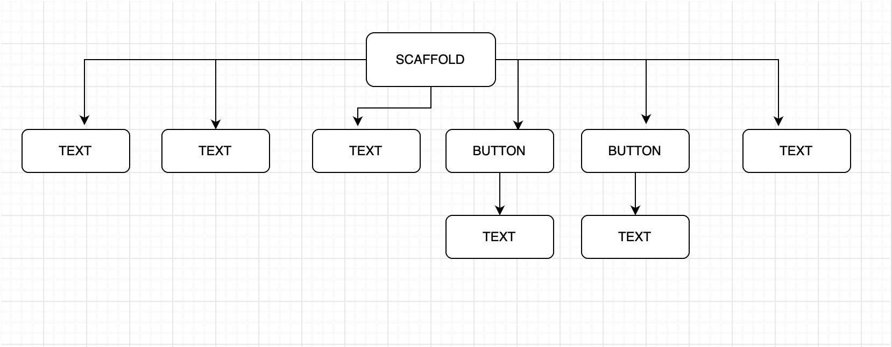
System Design
Greetings Page
VII Semester, Department of ISE, RNSIT
2021 - 2022

Slide 9
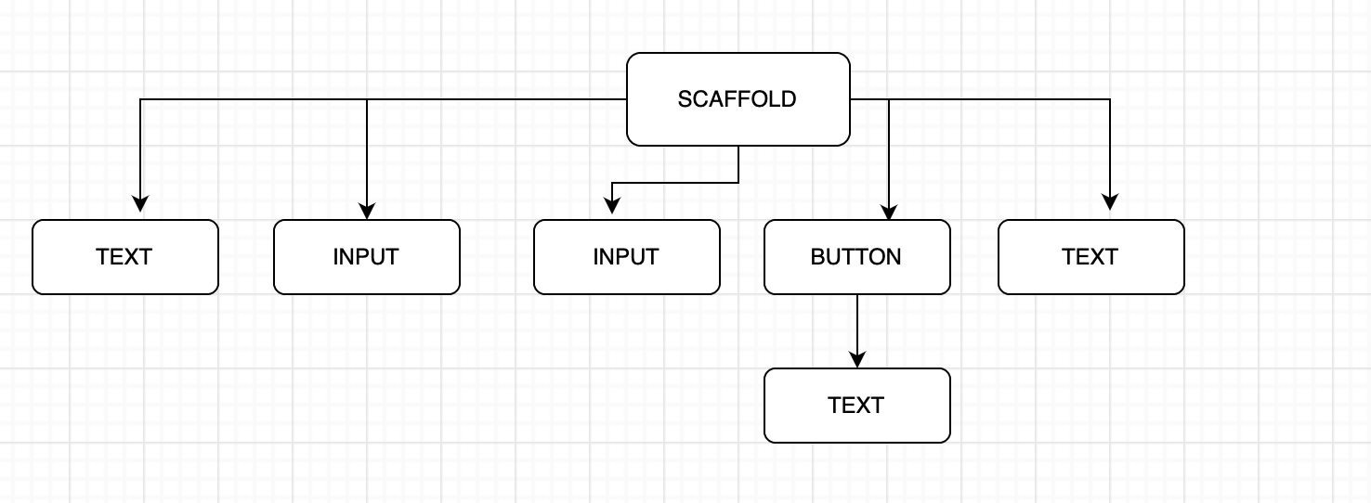
System Design
VII Semester, Department of ISE, RNSIT
2021 - 2022

Slide 10
Schema Design
GREETINGS PAGE
LOGIN PAGE
BROWSING PAGE
GALLERY PAGE
SETTINGS PAGE
VIII Semester, Department of ISE, RNSIT
2021 - 2022

Slide 11
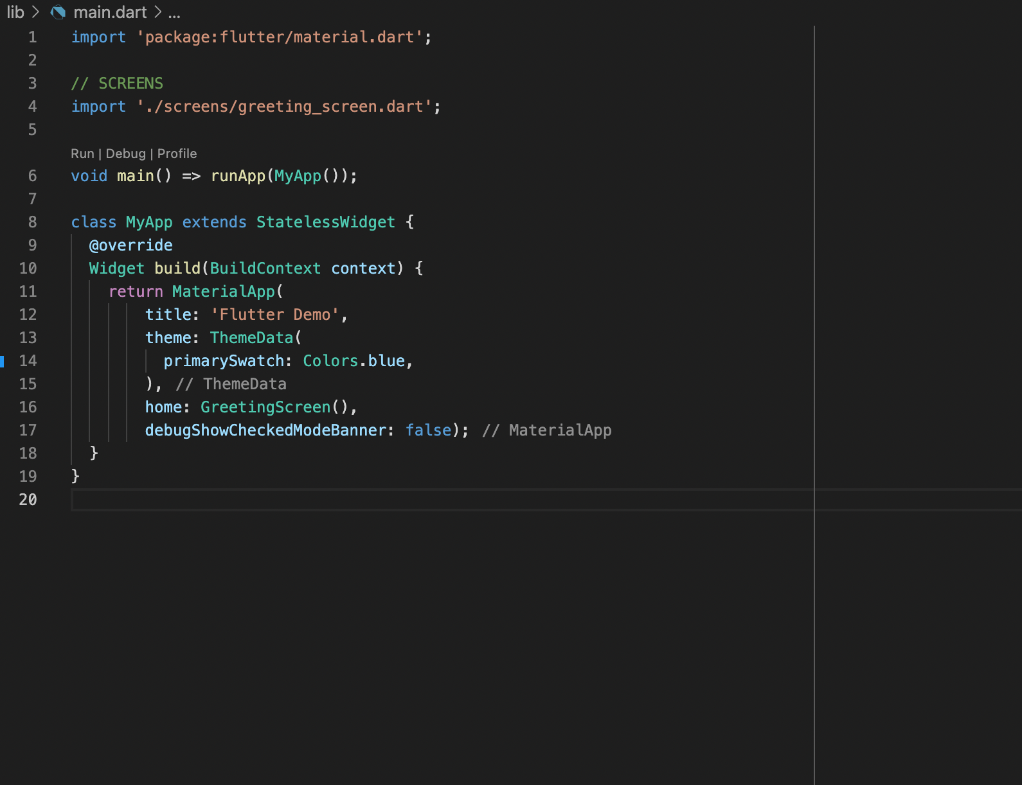
Implementation / Coding
VII Semester, Department of ISE, RNSIT
2021 - 2022

Slide 12
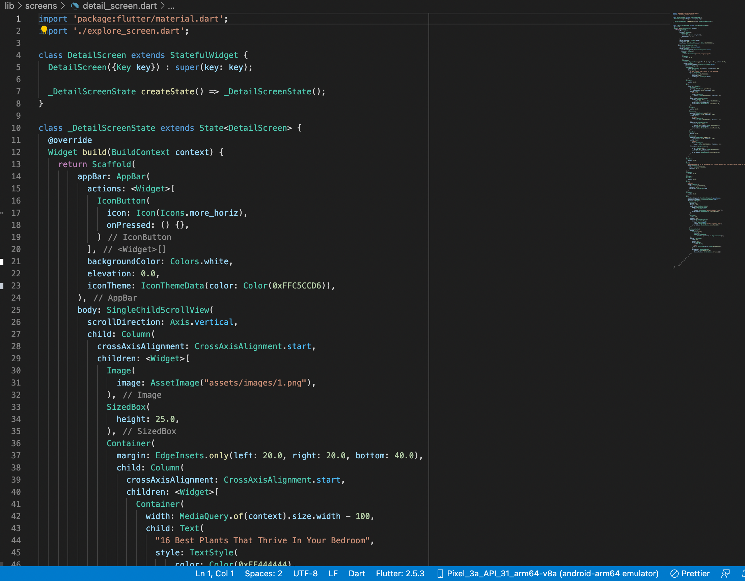
Implementation / Coding
VII Semester, Department of ISE, RNSIT
2021 - 2022

Slide 13
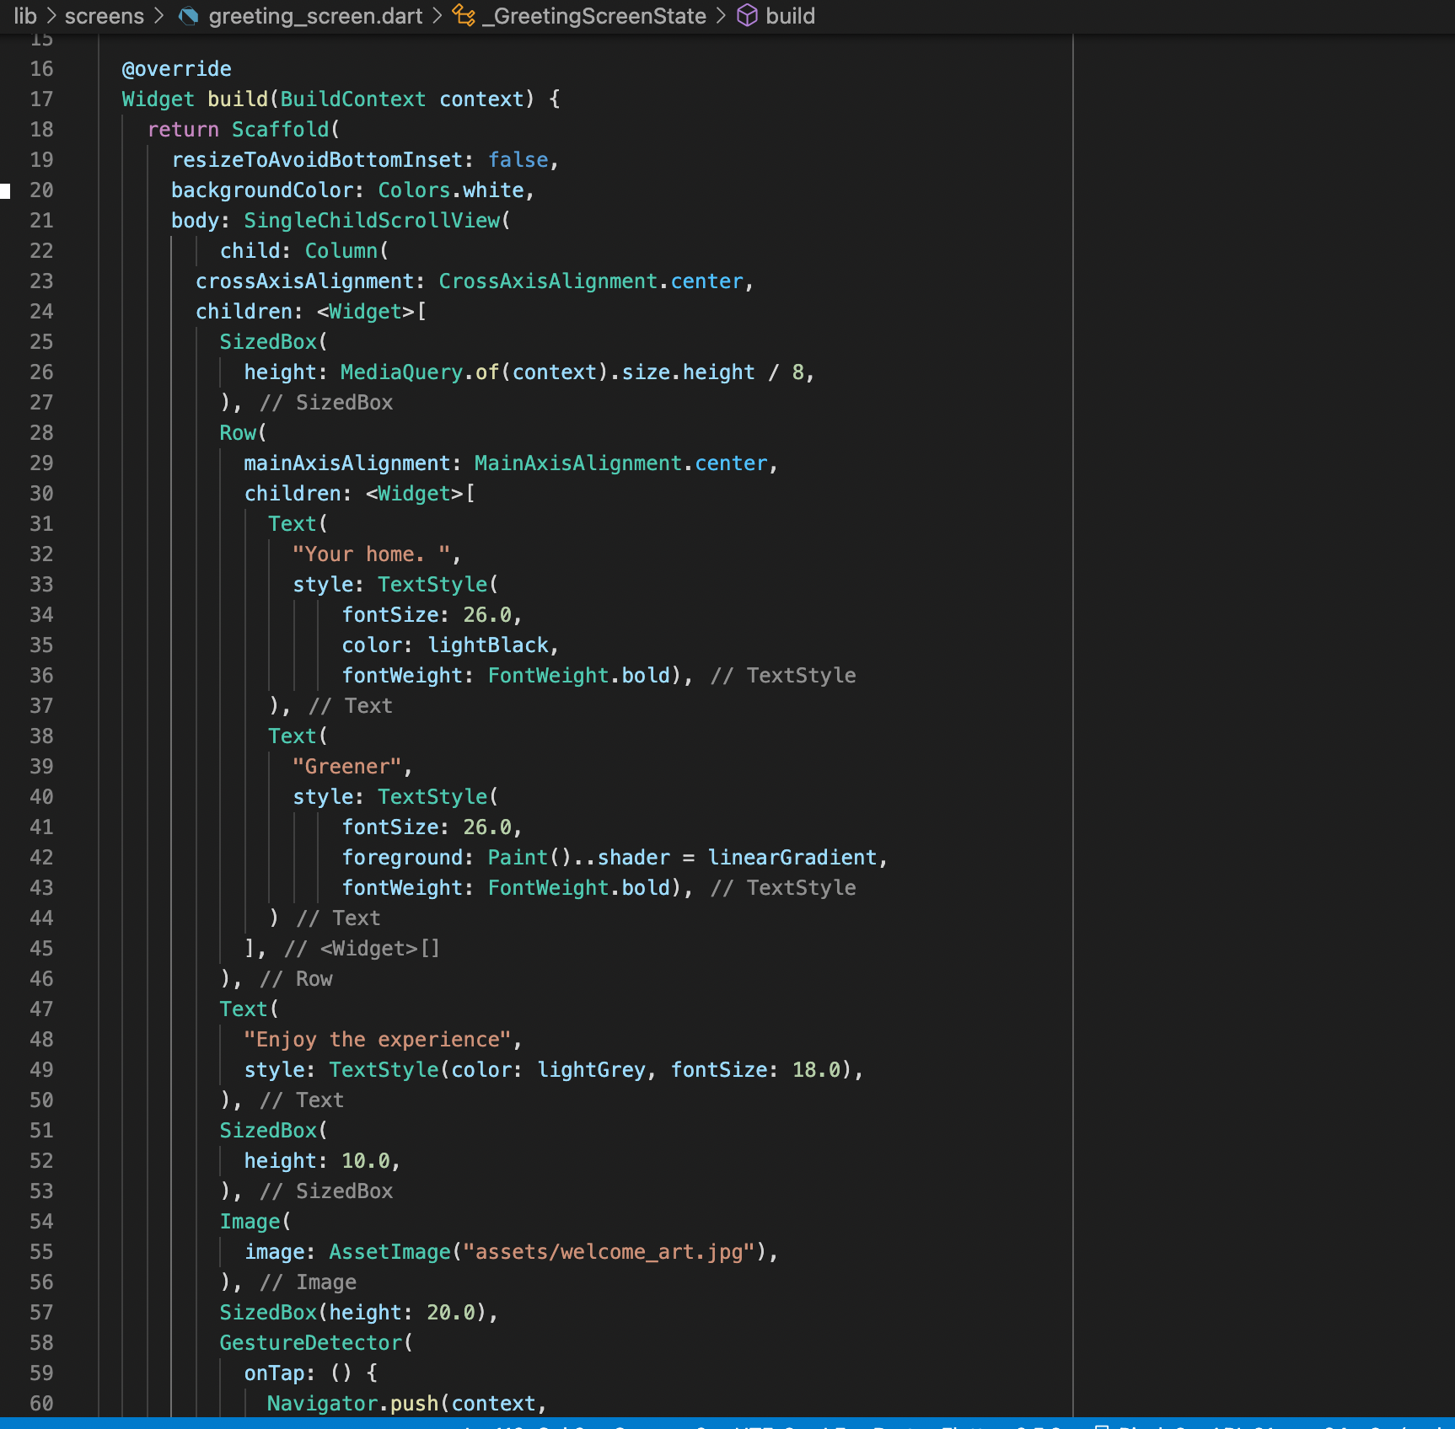
Implementation / Coding
VII Semester, Department of ISE, RNSIT
2021 - 2022

Slide 14
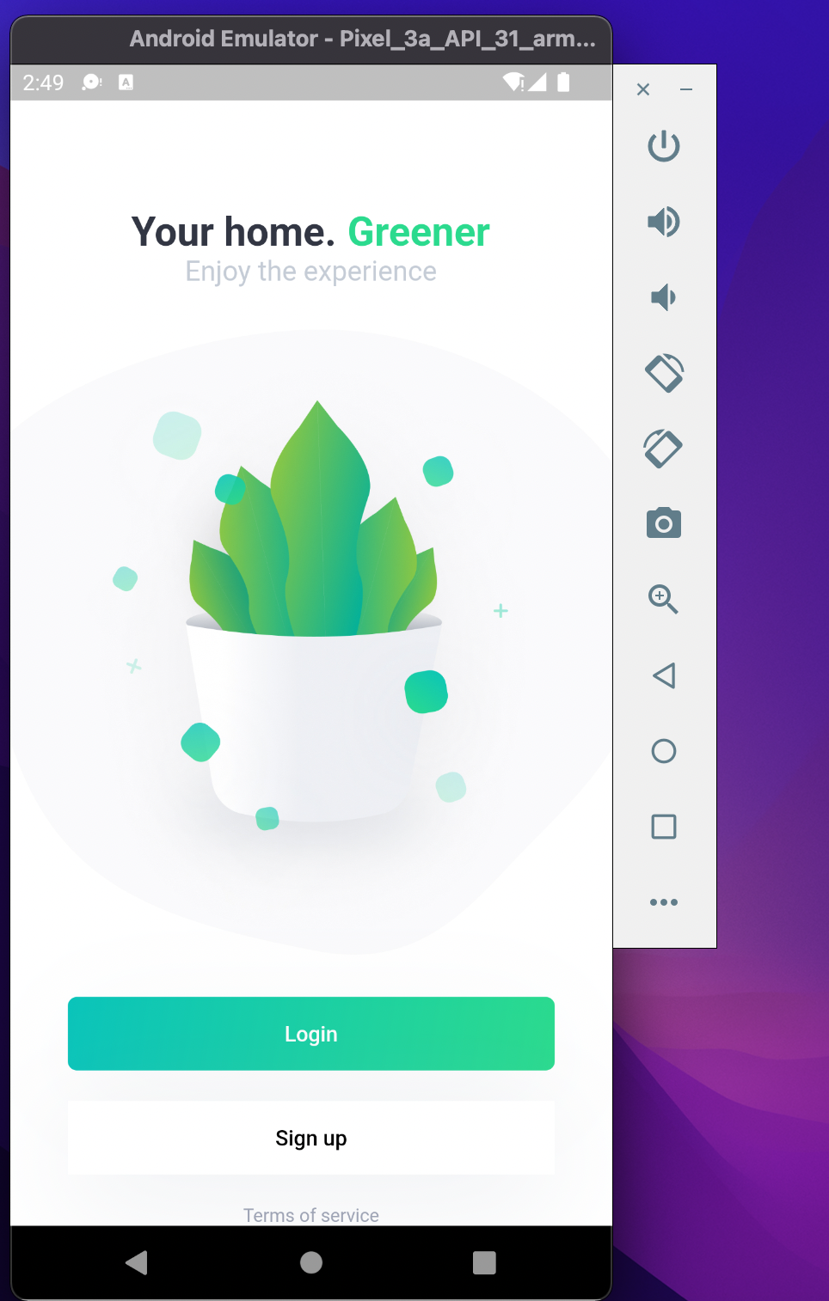
Result
VII Semester, Department of ISE, RNSIT
2021 - 2022

Slide 15
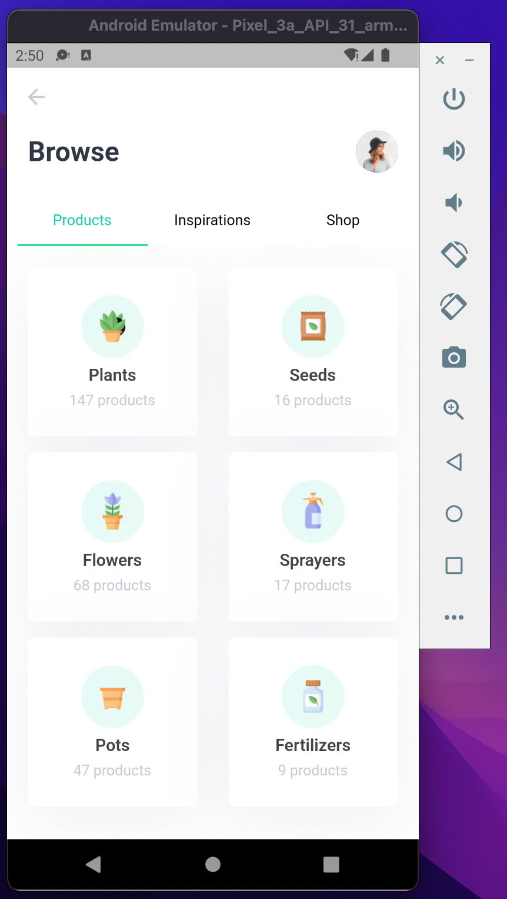
Result
VII Semester, Department of ISE, RNSIT
2021 - 2022

Slide 16
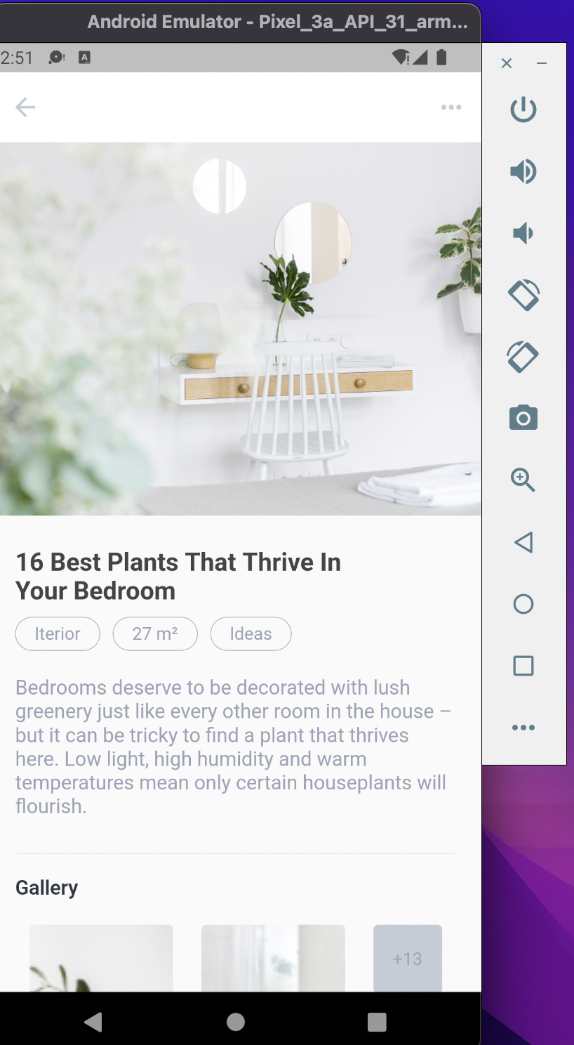
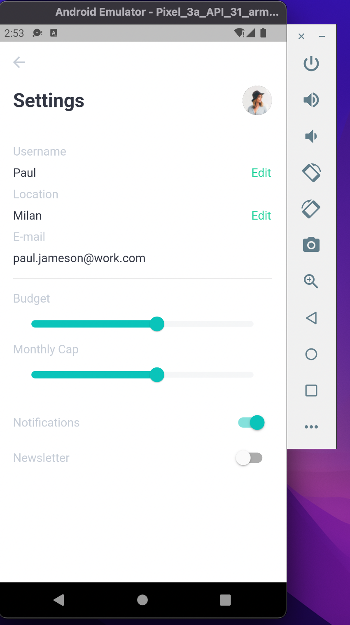
VII Semester, Department of ISE, RNSIT
2021 - 2022

Slide 17
Testing
Testing is a process of executing a program with the interest of finding an error. Levels Of Testing
Unit Testing
Integration Testing
Validation Testing
Output Testing
User Acceptance Testing
VII Semester, Department of ISE, RNSIT
2021 - 2022

Slide 18
CONCLUSIONS
This plant application provides facility to gain knowledge about any varieties of plants on your fingertips.
It save time since user does need to go to nursery.
Descriptions and pictures about plants, seeds ,fertilizers etc are given properly.
VII Semester, Department of ISE, RNSIT
2021 - 2022

Slide 19
Future Enhancements
We can try and deploy it on the internet so that people can access it online also.
We can try to add backend to the app and host it on server.
We can also let different user access the app simultaneously with their unique id.
VII Semester, Department of ISE, RNSIT
2021 - 2022

Slide 20
REFERENCES
SQL Tutorial-java point
Guru99.com
C#- Geeks for geeks
VII Semester, Department of ISE, RNSIT
2021 - 2022

Slide 21
VII Semester, Department of ISE, RNSIT
2021 - 2022

Slide 22

VII Semester, Department of ISE, RNSIT
2021 - 2022

